Slide 1
Snapchat Instructional

Slide 2
Basic Buttons
1
2
3

Slide 3
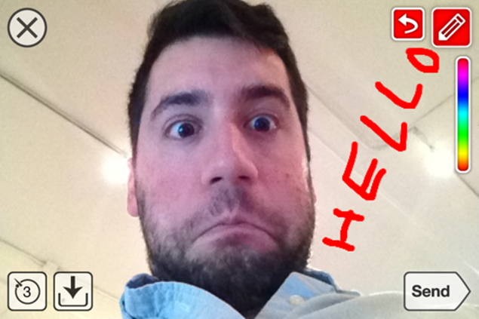
Adding Stuff
4
2
3

Slide 4
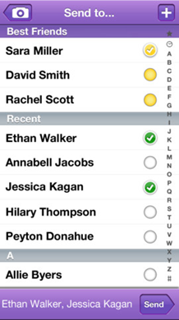
Adding Friends and Sending
1
3
2

